Slide 1
SMART INDIA HACKATHON 2020
Ministry/ Organization name: Government of Andhra Pradesh Problem Statement : AI and OCR - To search Telugu & Urdu words in PDF present in Unicode as well as in image format Team Leader Name : Shiva Baghel College Code : U-0507
Team Name :The Run Time-Terror

Slide 2
Idea Brief
To create an independent portal/App for the user to convert given .pdf or Image.
User can search in given pdf or image
Multilingual including Telugu, English, Urdu
Unicode presence

Slide 3
PyTesseract A python library to perform OCR
Django For Portal Development
Technology Stack
OpenCV/Pillow For Image Processing Operation
Machine Learning For Classification of Data

Slide 4
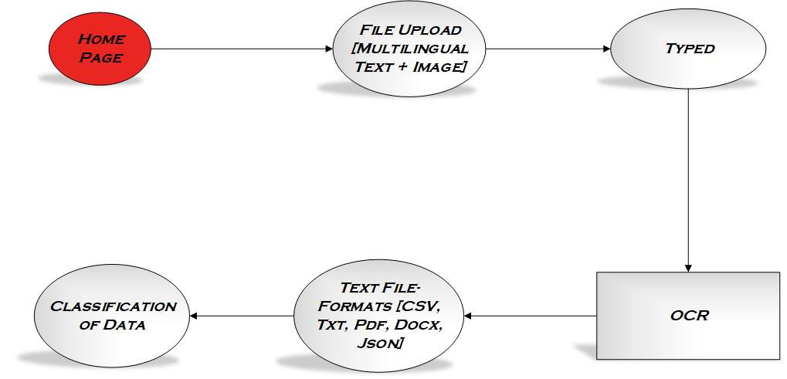
Use Cases

Slide 5
First step
PDF or image OCR
Image Preprocessing
Noise remove
Thresholding
Enhance image quality
Crop extra area

Slide 6
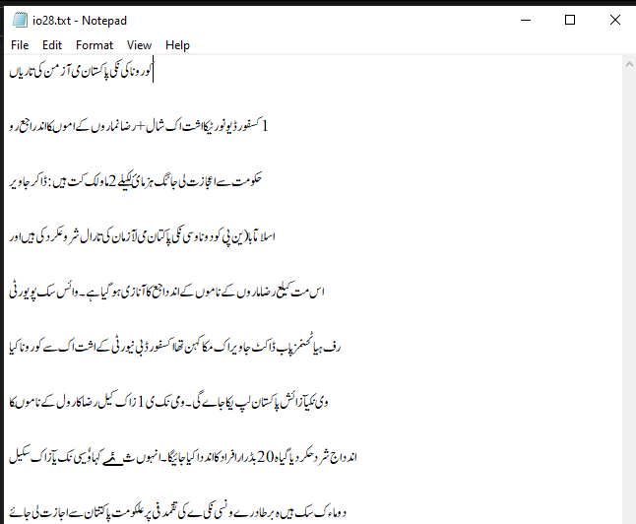
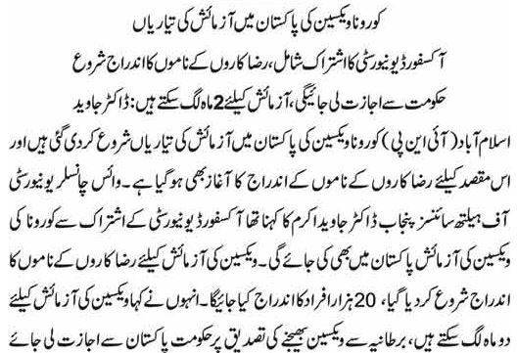

Slide 7
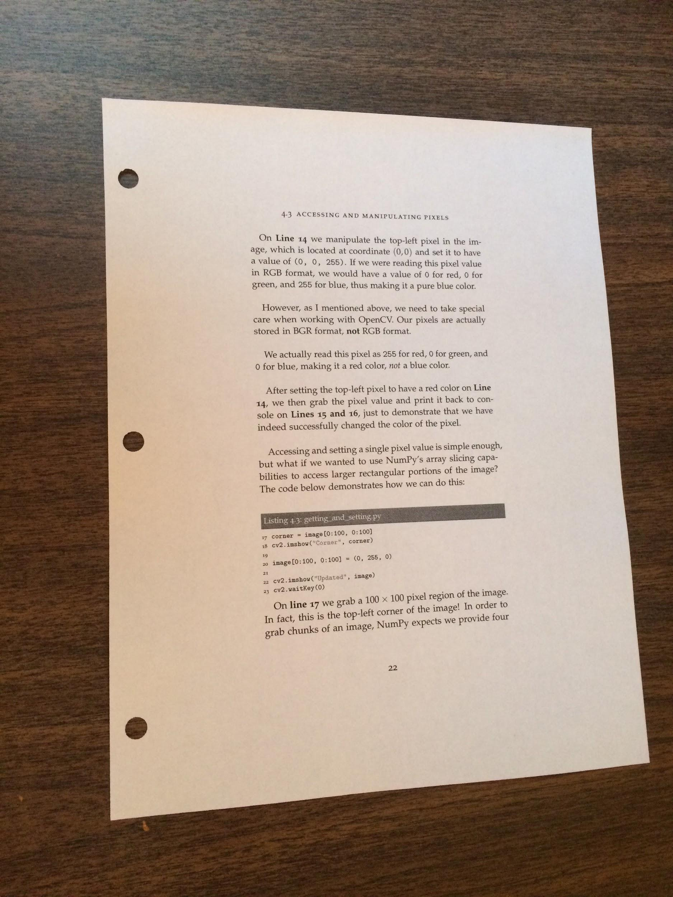
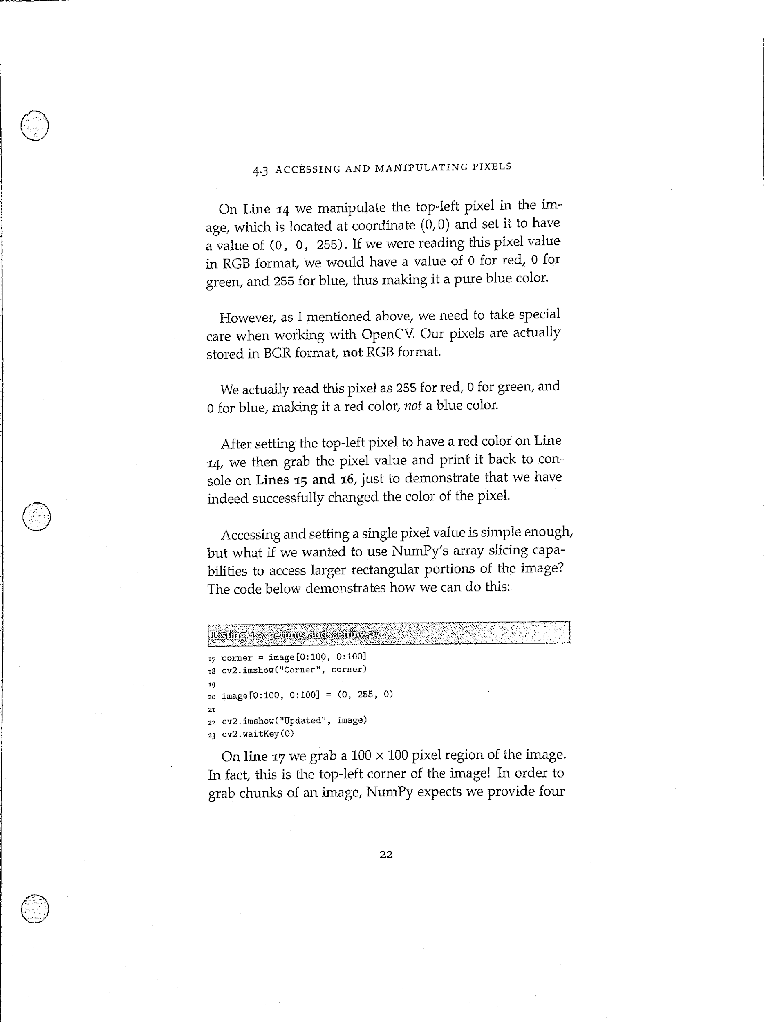
Results after applying filter in image processing
Before After After

Slide 8
Middle step
Search Program
Text pattern search with regex
Unicode are used for Telegu and Urdu.
Highlight text if found.

Slide 9
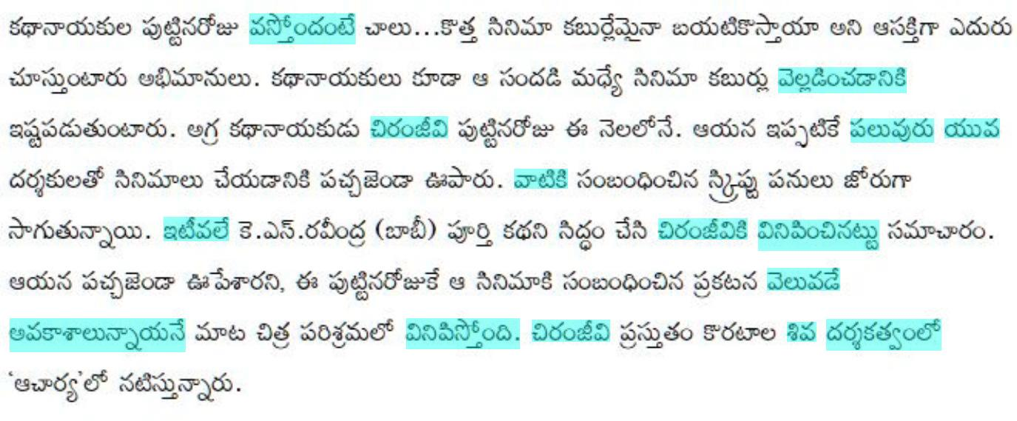

Slide 10
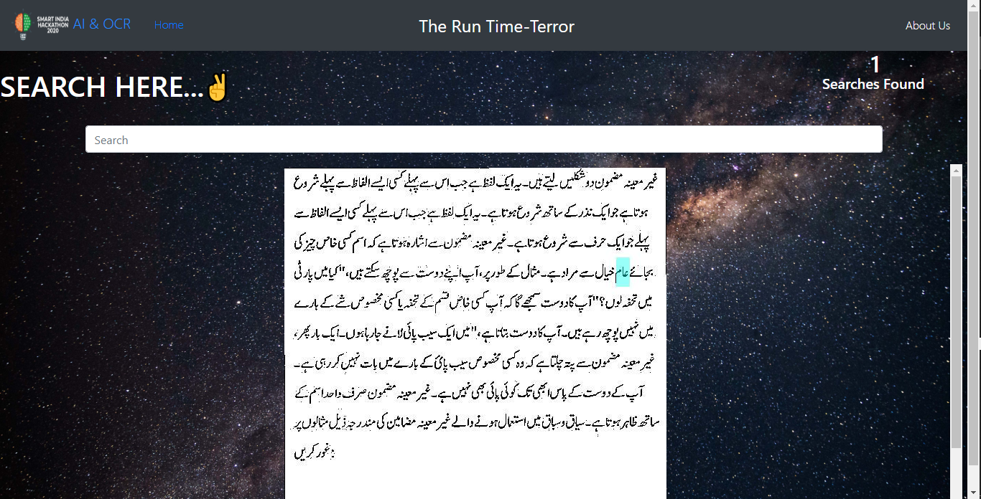

Slide 11
Features apart from problem statement
TEXT BLOCK
a block containing all the text present in pdf or image ,that can be copied to the clipboard.
Translated And corrected Text Block
block containing all the text found in the image or pdf in english format irrespective of the languages present in text, with corrected grammar and spellings after applying NLP techniques.

Slide 12
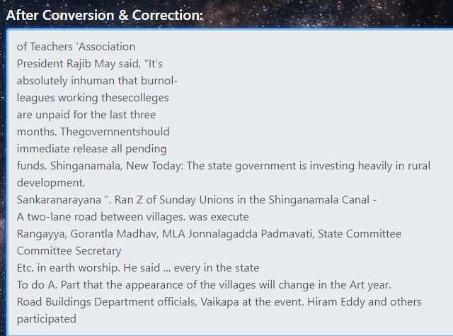

Slide 13
Final Step
Web app design
Html
Django

Slide 14
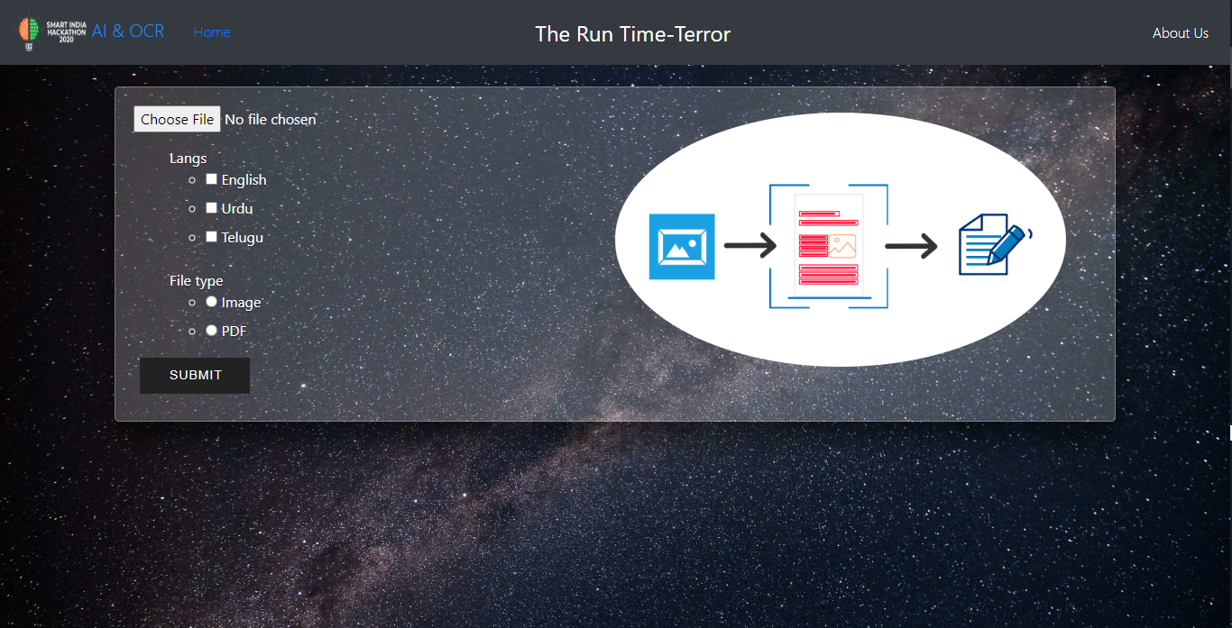

Slide 15
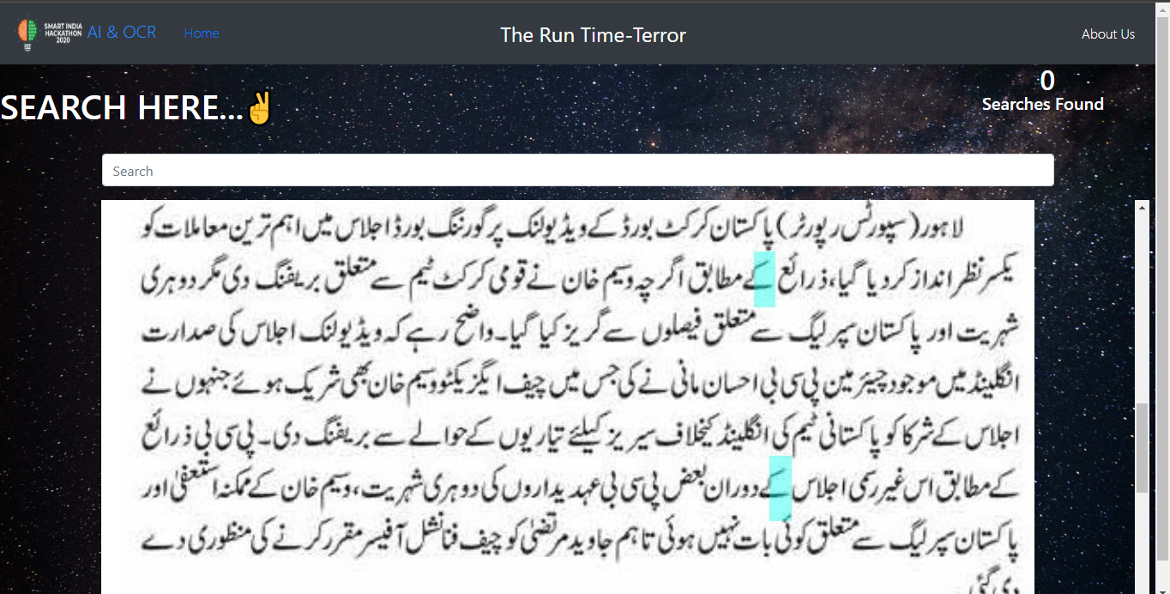

Slide 16
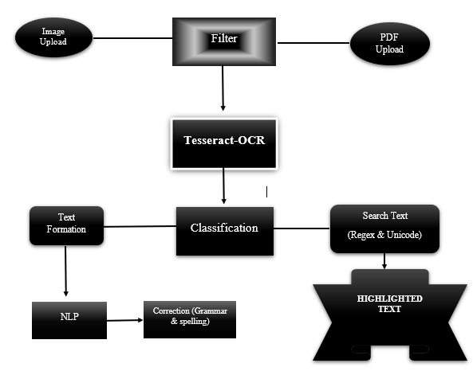

Slide 17
Thank You

